Slide 1




“AI Infinity ∞” Flash Card Design Acitivity
Artwork Guidelines
1.Use the generative AI tools to create an image related to English Word, idioms, or proverbs.
2. Write a multiple-choice question related to the image.
3. Provide one correct answer and three incorrect answer choices.

Slide 2

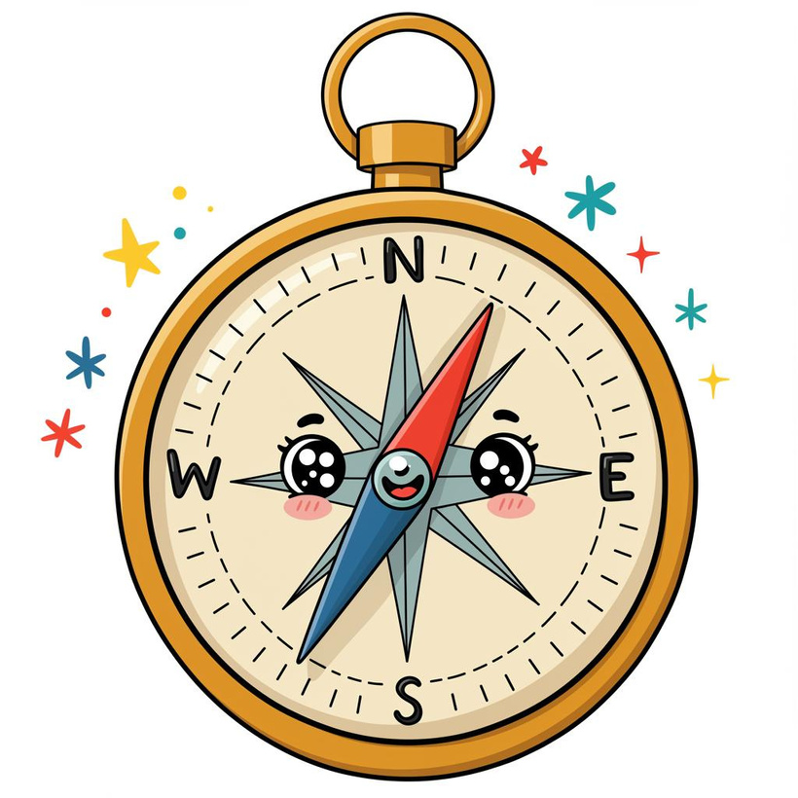

“AI Infinity ∞” Flash Card Design Acitivity
(Sample)
Look at the image on the right. What is the correct English word for this object?
A) Thermometer
B) Compass
C) Protractor
D) Calculator
Answer: B) Compass

Slide 3

“AI Infinity ∞” Flash Card Design Acitivity
(Input your content here)
(Post your artwork here.)

